Slide 1
Texas holdem
With mvc and objects with JavaScript and php

Slide 2
1. Project goal
Create Texas Holdem game
By using MVC or Model-View-Controller
Using Objects of JavaScript and php

Slide 3
2. Steps
Make a program with C++ to figure out how to embody Texas Holdem card game into a computer program
Analyze it to plan how to utilize JavaScript and php to our project
Step1
Step2
Understand MVC concept throughout comparison between sample game, BattleShip and Texas Holdem
Step3
Apply objects created by C++ to JavaScript and php with the concept of MVC

Slide 4
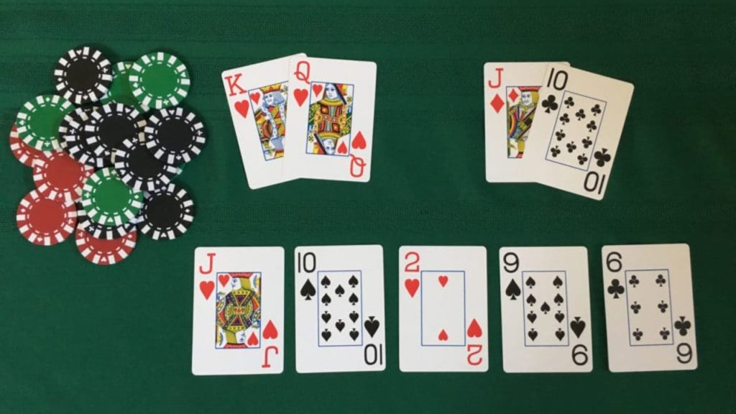
Understanding of Texas holdem 1 - how to distribute cards
(1) Preflop - Each player receives two Cards
Each Player
Preflop (2Cards)
Bet 1
Community
Flop (3Cards)
Bet 2
Turn (1Card)
Bet 3
River (1Card)
(2)flop
(3)turn
(4)river
- Dealer throw away a card of deck
Bet 4

Slide 5






Understanding of Texas holdem 2 - rank of hands
Texas Holdem is one of Poker game which has a unique rank of hands created by combinations of pairs and sequences of face and suit with five cards
Rank of Hands | Examples
(Royal) Straight Flush | Straight + Flush
Four of a kind
Full House | Three of a kind + a pair
Flush | Five cards with same kind of suit
Straight | Five cards in a sequence
Three of a kind, Two pairs, One Pair

Slide 6
Understanding of Texas holdem 3 - Given or predestined condition
The number of players
The result of shuffle
Game Rule
Betting strategy of another players (Bluffing vs Reasonable Decision) – That is, it’s not only about a calculation of probability. Rather, it’s about a figuring out another player’s betting strategy and its pattern. In this reason, our project is limited with human players.
e.g. Big Blind should initially put money into the pot mandatorily (Small Blind ~ ½)
Dealer distributes cards with a clock-wise order
Procedure ~ “preflop”, “flop”, “river”, “turn”
After each procedure, dealer throw away a card

Slide 7
Understanding of Texas holdem 4 - What players can decide
Join/quit/just watch a game
Betting strategy: check / call / raise / fold
check
Decide to keep going in this round of a game
Check: players[i].active==1 && players[i].bet($0)
Call: players[i].active==1 && players[i].bet($a)
Raise: players[i].active==1 && players[i].bet($a+$b)
call
raise
fold
Decide to stop here in this round of a game
Fold: players[i].active from 1 to 0
($a= amount that previous player bet, $b=additional amount current player bet)

Slide 8
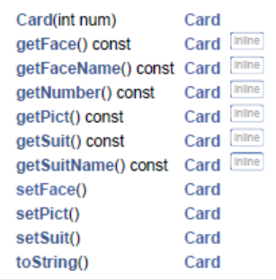
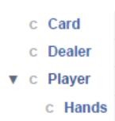
Objects in C++ - (1) Card
(1) Card Membership List
Class
Hierarchy

Slide 9
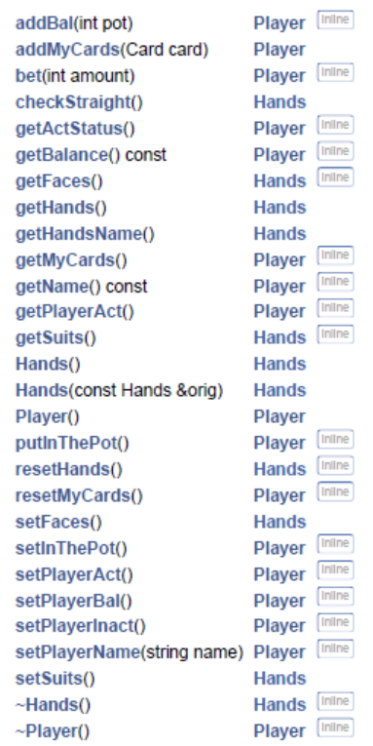
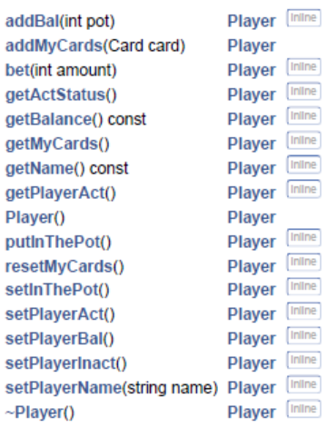
Objects in C++ - (2) Player, (3) Hands : Player
(3) Hands Membership List
(2) Player Membership List
Class
Hierarchy

Slide 10
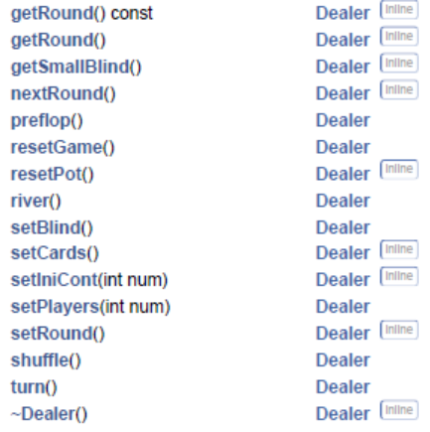
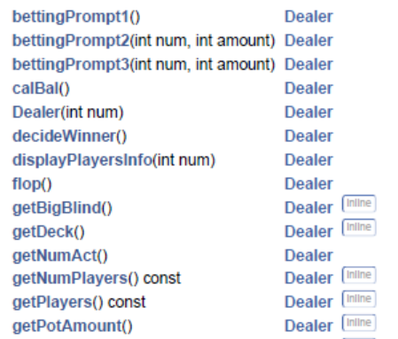
Objects in C++ - (4) Dealer
(4) Dealer Membership List
Class
Hierarchy

Slide 11
MVC - battleship vs. Texas holdem 1
 | Battle Ship | Texas Holdem
Player’s Discretion | Guess = the location of a table | Decide to keep going or Stop the game with betting strategy
Given Condition | Locations of ship created randomly | Order of cards throughout shuffling
View::displayMessage function (msg) | Model::fire function(guess) (1)“Oops, you already hit that location” (Input validity) (2)“You sank my battleship!” (3)“HIT!” and “You missed!” 2. Controller::processGuess(guess) (1)“You sank all my battleships …” | Deal::preflop(), flop(), river(), turn() “player[i] checked” “player[i] called $x” “player[i] raised $x” “player[i] folded” 2. Controller::decideWinner(Hands); “Player[i] won $x in 10th round” 3. Controller::checkPlayers(Deal); “player[i] joined/quited” “player[i] won and earned total $X” (ini & terminate)

Slide 12
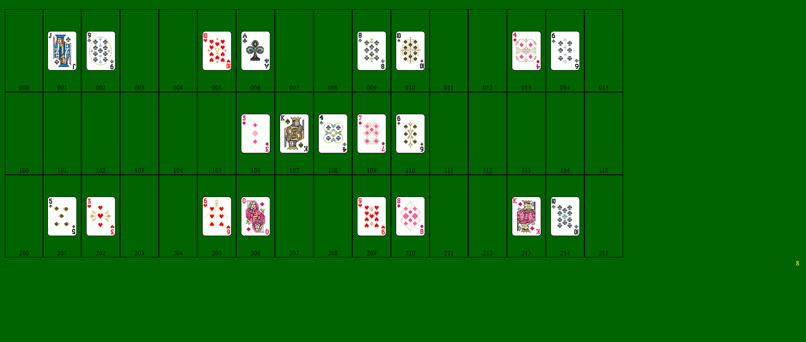
Attachment 1 - CSS & HTML of Texas Holdem
* - plan
Name: …
CurrentBalance: $
Money in the Pot: $
Log
P1 checked
P2 raised to $20
P3 folded
P4 folded
P5 called
P6 quit
……..
……..
……..
……..
……..
……..
……..
……..
p8
………
p1
………
p2
………
p3
………
Total amount in the pot
&& list amount of each player
p7
………
p6
………
p5
………
p4
………
Player[i]
Check/call
Raise
Fold

Slide 13
MVC - battleship vs. Texas holdem 2
 | Battle Ship | Texas Holdem
View::display[picture] | Model::fire function(guess) calls view::displayHit(location) and view::displayMiss(location) | Deal::preflop, flop, river, turn function() calls view::displayCard(location, players[i].myCards[j].picture)
Initiate a game | HandlersInit.js with guess input | HnadlersInit.js with number of players input After initiating the game, we have to handle betting buttons similarly (waiting next players decision or dealer’s action)
Model | Locate ships randomly to cells of the table Reflect player’s guess to the location Show the result of player’s guess | Classes : Card => 2. Player => 3. Deal => 4. Hands

Slide 14
MVC - battleship vs. Texas holdem 3
 | Battle Ship | Texas Holdem
Controller.js | It says when this game is done such as the case that player hits all the ships. Translates user’s input of guess (“A2”) to array location of table(“02”) | Round control (static NROUND ++) => Card distribution order change => rotates the order of big and small blind => As NROUND increases, base amount goes up 2. In the betting process, it changes the status of the player (when they fold, players[i].active = 1 ➔0) It Decides a Winner and verifies the changes of balance for each player (players[i].bal >0, betting amount <players[i].bal) When a player quit, removes the player[i]’s object When a player took all the balance of other players or all the players quit, then it terminates the game. It asks if players want to do another game and prepare the next game with resetting players.

Slide 15
Improvements - to do list for final
Figuring out a way to communicate between php and JavaScript
Players can log in and have their own different view. They also can see other players game without joining the game.
Exceptional case study, e.g. all-in situation(call betting amount > players[i].balance), immediate winning decision when all other players folded
Display various message depending on each event
Do…while memory clearing issue
Do{
play game (preflop() → flop() → turn() → river() →decideWinner() → resetRound()
nRounds++;
rotate distributing cards order;
}while(all players not quit || more than two players still play game)

